Slide 1

ROCKBUSTER New Online Video Service Launch Strategy
By Andreas Tocci
12/02/2025

Slide 2
Key Questions and Objectives
● Which movies contributed the most/least to revenue gain?
● What was the average rental duration for all videos?
● Which countries are Rockbuster customers based in?
● Where are customers with a high lifetime value based?
● Do sales figures vary between geographic regions?
* All Data used for this Analysis came from the Rockbuster Data Base *

Slide 3
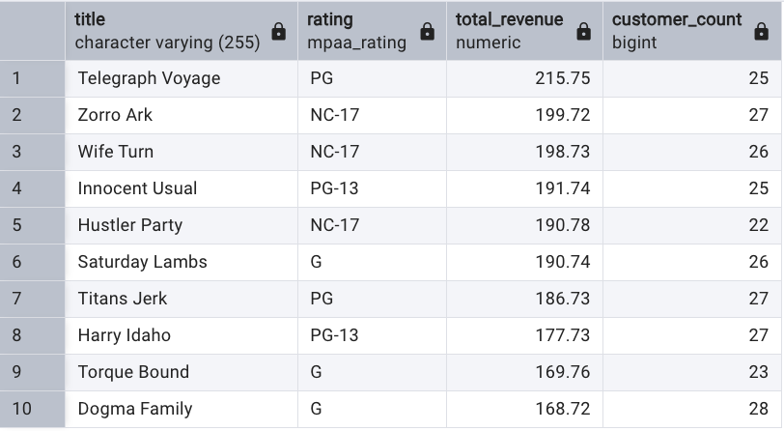
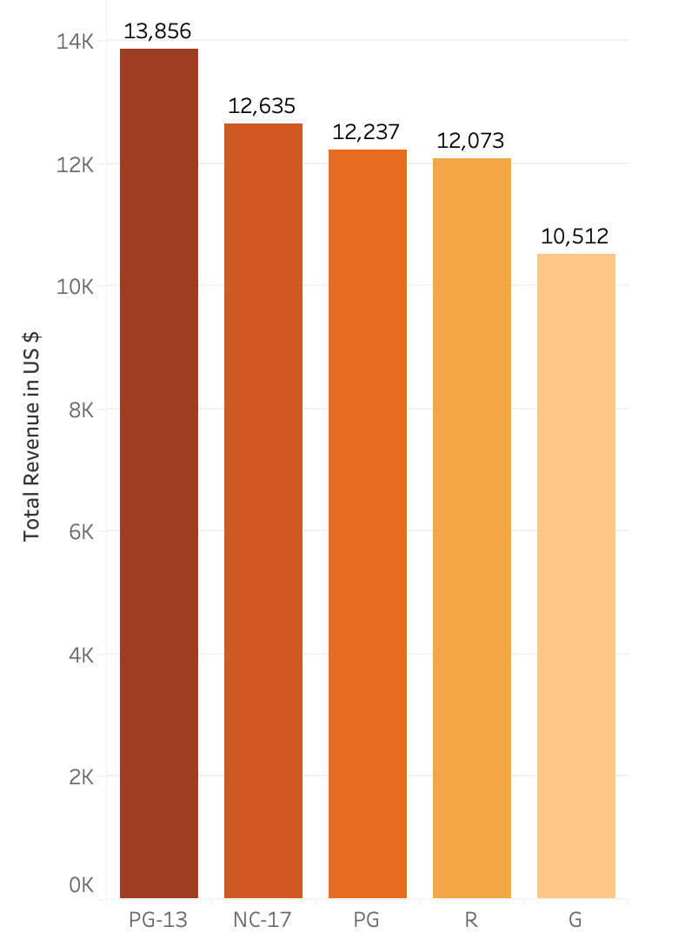
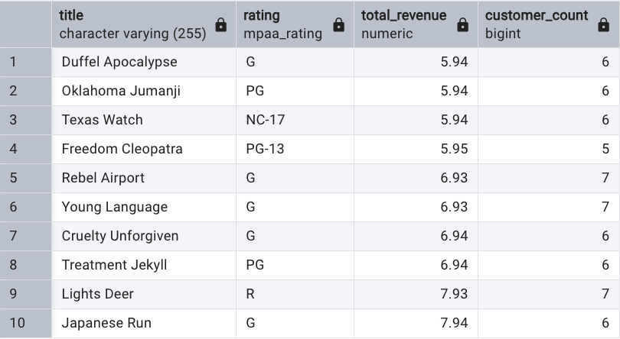
Rockbuster Movies and Revenue
Top 10 Movies By Revenue
Total Revenue by MPAA Rating
Average Movie Length:
115.272 mins
Bottom 10 Movies By Revenue

Slide 4
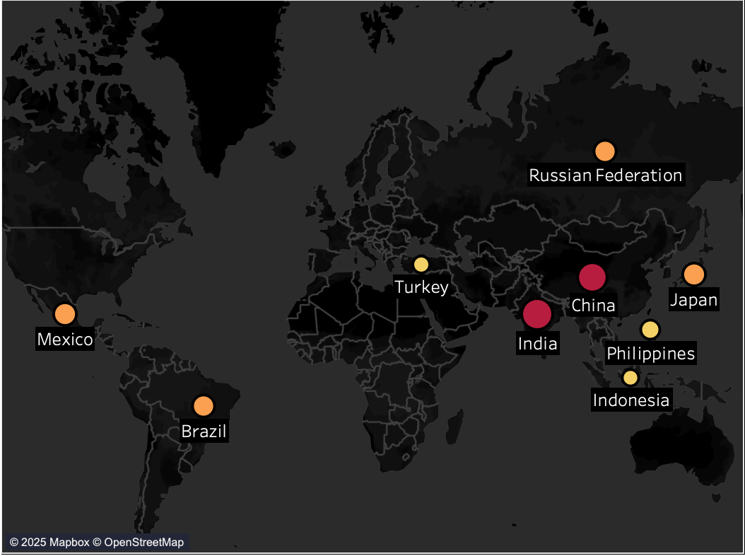
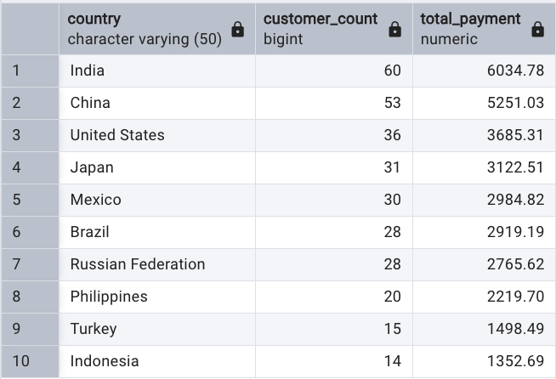
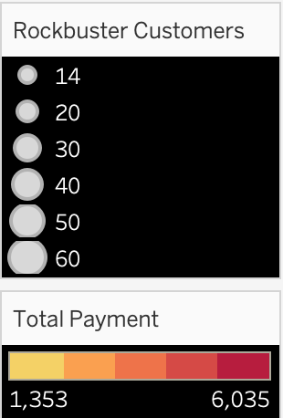
Top 10 Countries By Revenue and Customers

Slide 5
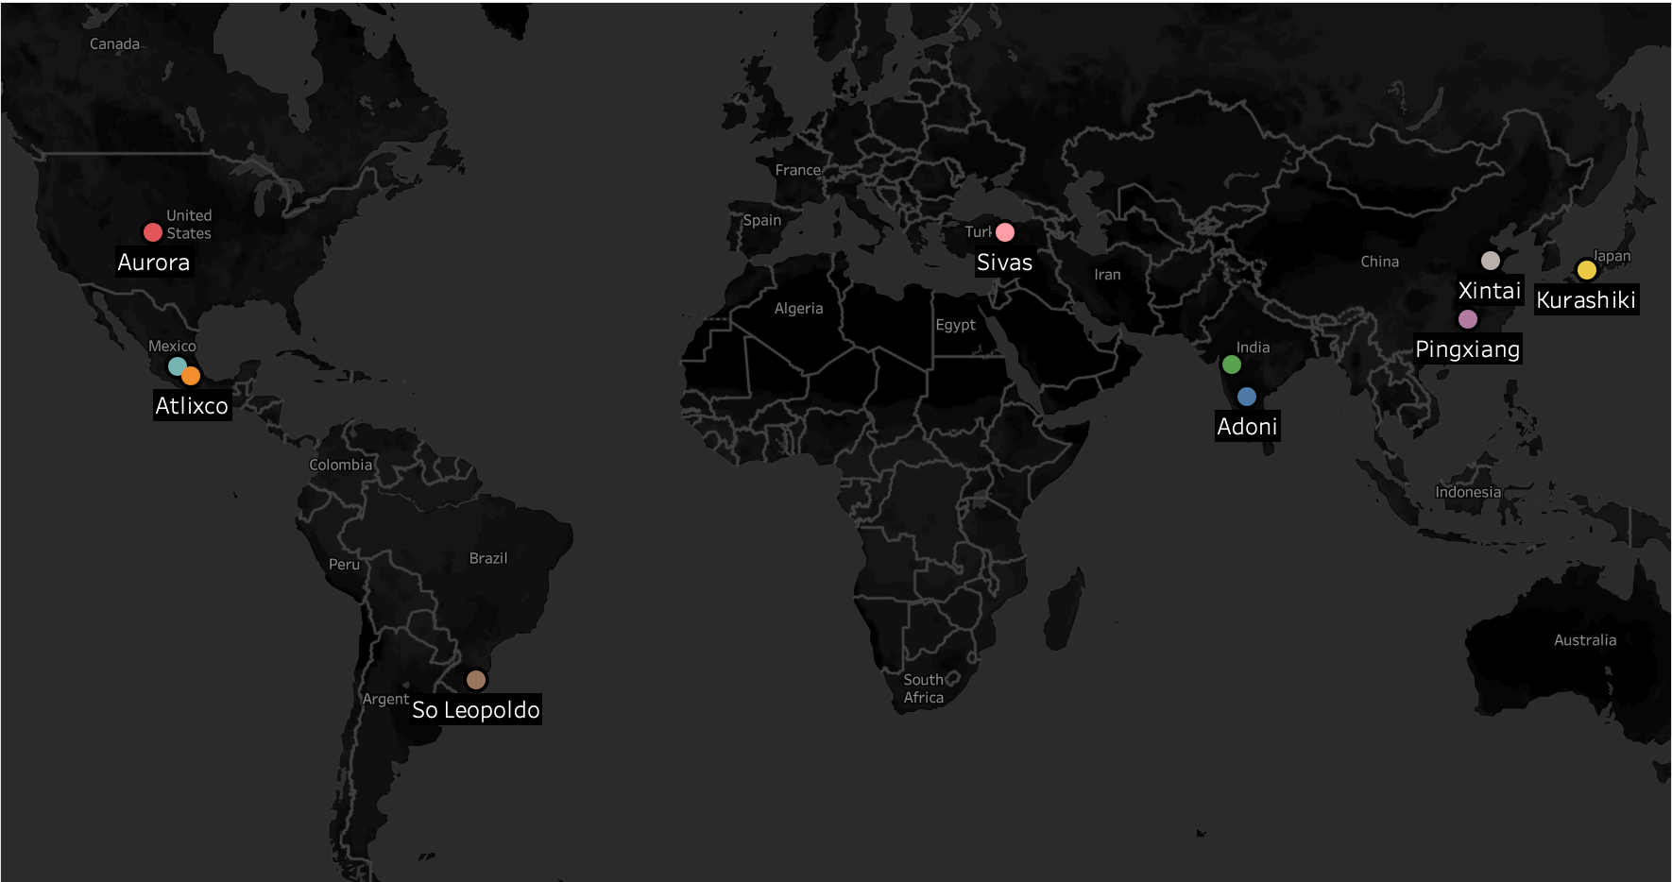
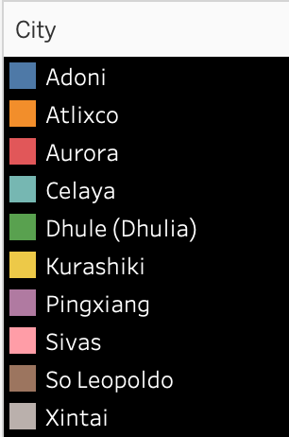
Top 10 Cities in Top 10 Countries

Slide 6
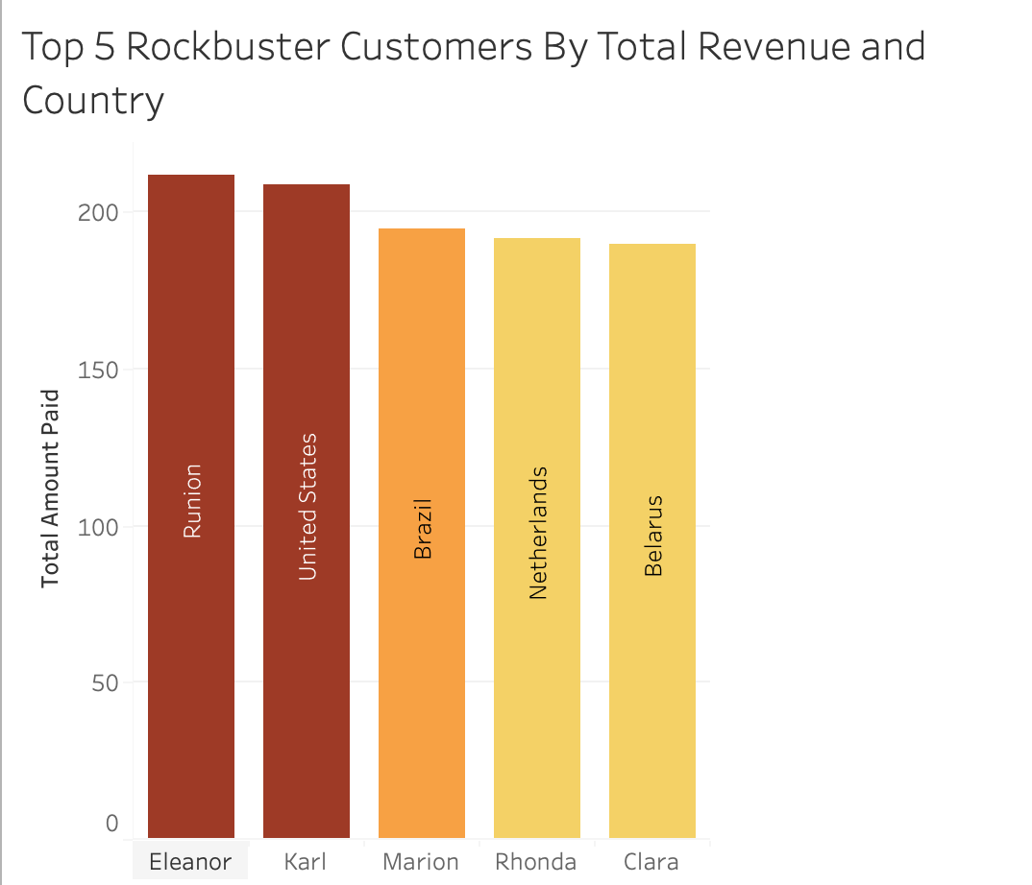
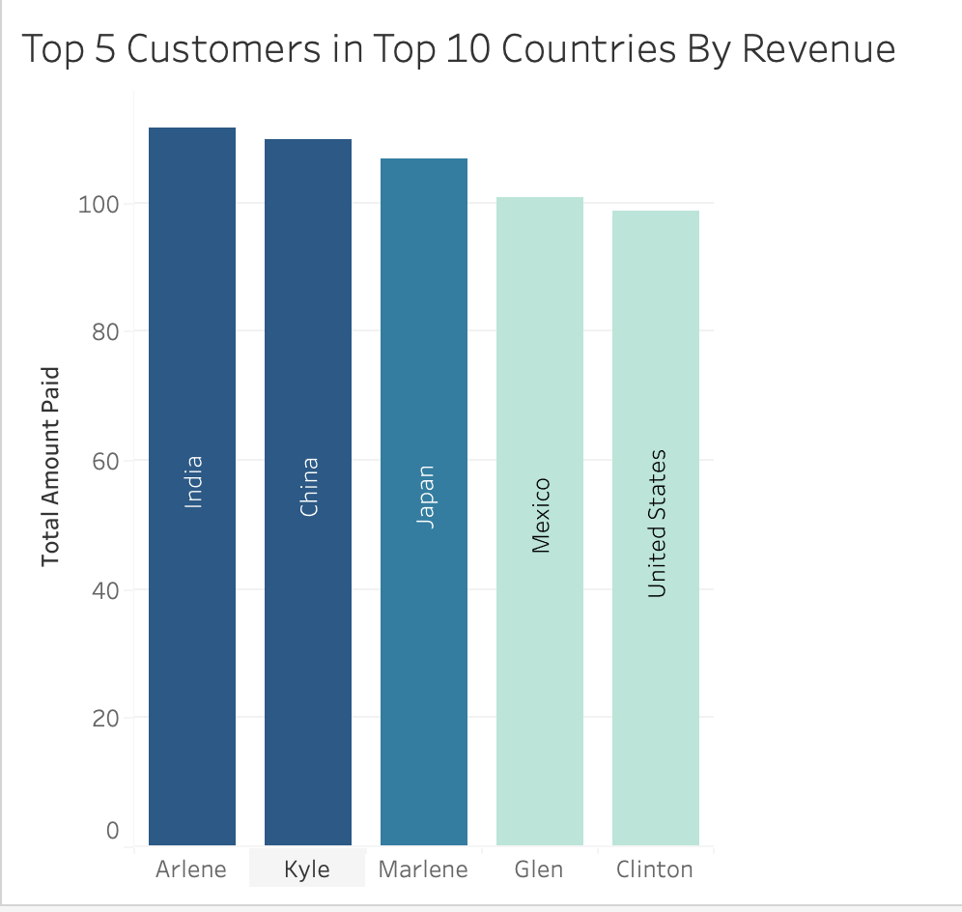
Top 5 Customers

Slide 7
What Does This Show?
PG-13 are Rockbuster’s most popular MPAA rated movies
India, China, United States, Japan, Mexico, Brazil, Russian Federation, Philippines, Turkey and Indonesia are Rockbuster’s Top 10 Countries by Revenue
5 of the Top 10 Countries by Revenue are in Asia

Slide 8
Possible Next Steps
Create a Reward system for top customers or for customers that pass a certain spend threshold to increase customer loyalty.
Focus campaigns on Countries with highest revenue
Increase Film Inventory. All films in the inventory are from 2006 there are many movies before and after that are heavily sought after an investigation and analysis may be performed to gather more data.
Create a survey to understand customer experience will help Rockbuster gain key information on what to improve and, what kind of movies they would like for Rockbuster to bring.

Slide 9
Tableau Graph Links
https://public.tableau.com/app/profile/andreas.tocci/viz/MapofRockbusterCustomersbyCountryandTotalPayment/Sheet1?publish=yes
https://public.tableau.com/app/profile/andreas.tocci/viz/TotalRevenuebyMPAARatingRockbuster/Sheet1?publish=yes
https://public.tableau.com/app/profile/andreas.tocci/viz/Topp10CitiesinTop10CountriesbyRevenueRockbuster/Sheet1?publish=yes
https://public.tableau.com/app/profile/andreas.tocci/viz/Top5RockbusterCustomersByTotalRevenueandCountry/Sheet1?publish=yes
https://public.tableau.com/app/profile/andreas.tocci/viz/Top5CustomersinTop10CountriesByRevenueRockbuster/Sheet1?publish=yes
https://public.tableau.com/app/profile/andreas.tocci/viz/Top10CountriesbyCustomersandRevenueRockbuster/Sheet1?publish=yes

